Slide 1
sentiment analysis of Restaurant reviews
CAPSTONE PROJECT
Presented By:
Student Name : Peddimudi HymaVathi
College Name & Department : Vsm College of Engineering & Computer Science

Slide 2
OUTLINE
Problem Statement
Technology used
Wow factor
End users
Result
Conclusion
Git-hub Link
Future scope

Slide 3
Problem Statement
PROBLEM STATEMENT:
In today’s world social media have a huge impact on our lives whether its personal life or professional life. People are tend o make decisions based on what they see and hear on social media nowadays which is making a huge impact on businesses. So, the industries are tend to find ways to analyse and interpret insights from these information present over the social media, blogs and other internet platforms. One of the ways to utilise these data is analysing the sentiment of a particular user from the reviews he/she does over the internet on websites or blog posts. So, we will be developing a AI algorithm that detects sentiment of a user based on its review.

Slide 4
Technology used
Libraries:
os - For interacting with the operating system.
numpy - For numerical computations.
pandas - For data manipulation and analysis.
nltk - For natural language processing.
re - For regular expressions.
sklearn (scikit-learn) - For machine learning and evaluation metrics:
CountVectorizer
train_test_split
MultinomialNB
accuracy_score, precision_score, recall_score, confusion_matrix
matplotlib.pyplot - For creating visualizations.
seaborn - For statistical data visualization.

Slide 5
Wow factors
Unique Features of the Project:
Domain-Specific: Tailored for analyzing restaurant reviews.
Advanced Text Preprocessing: Utilizes NLP techniques like stemming, stopword removal, and regex cleaning.
Efficient ML Pipeline: Implements Naive Bayes with CountVectorizer and evaluates using multiple metrics (accuracy, precision, recall).
Visualization: Uses Matplotlib and Seaborn for clear, insightful visualizations.
Colab Integration: Easy access, collaboration, and data management via Google Colab.
Real-World Application: Helps restaurants analyze customer feedback to improve services.
Scalable & Customizable: Modular design allows easy expansion and adaptation.

Slide 6
End users
The end users of the "sentimental analysis of restaurant reviews" project could include:
1. Restaurant owners/managers
To analyze customer feedback and improve services based on sentiment trends.
To identify common complaints or areas of praise.
2. Marketing teams
To understand customer sentiment toward promotions or new menu items.
To tailor campaigns based on customer preferences.
3. Review platforms
Websites like zomato, yelp, or tripadvisor can use it to analyze reviews and rank restaurants.
4. Data analysts
To derive actionable insights from customer feedback data.
5. Customers
Indirectly benefit from improved services and personalized experiences.
6. Developers/researchers
To adapt and extend the project for other industries (e.G., Product reviews or e-commerce).

Slide 7
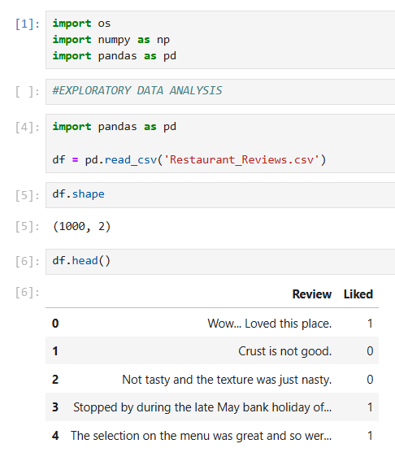
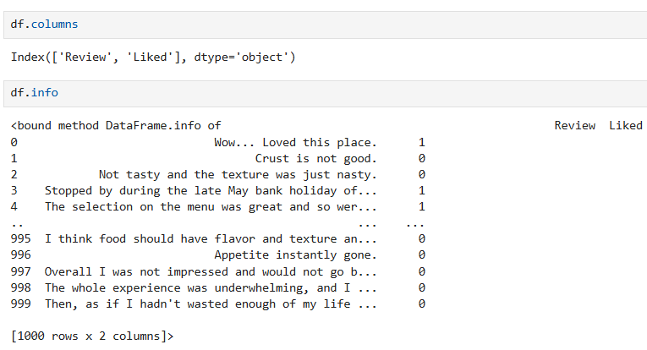
Results

Slide 8
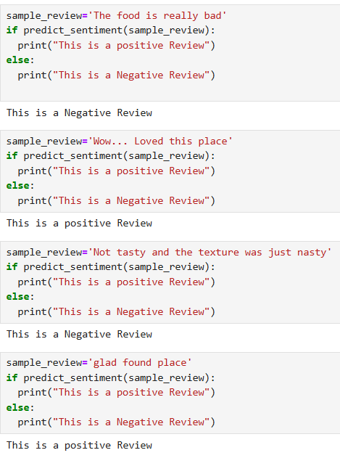
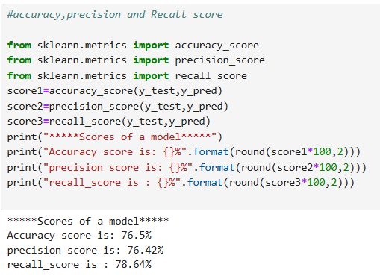
Results

Slide 9
Conclusion
Sentimental Analysis of Restaurant Reviews :
This project demonstrates the effective application of Natural Language Processing (NLP) and Machine Learning (ML) to analyze customer feedback. By preprocessing textual data, vectorizing it, and applying a Naive Bayes Classifier, it provides actionable insights into customer sentiments. The visualizations enhance interpretability, making it easier for stakeholders to understand sentiment trends.
The project’s scalability and adaptability allow it to cater to real-world needs, such as improving customer satisfaction, monitoring brand reputation, and optimizing marketing strategies. With further refinements, such as integrating advanced models or real-time deployment, this analysis can become a powerful tool for the restaurant industry.

Slide 10
GitHub Link
GITHUB REPO LINK : CLICK HERE

Slide 11
THANK YOU

